Slide 1
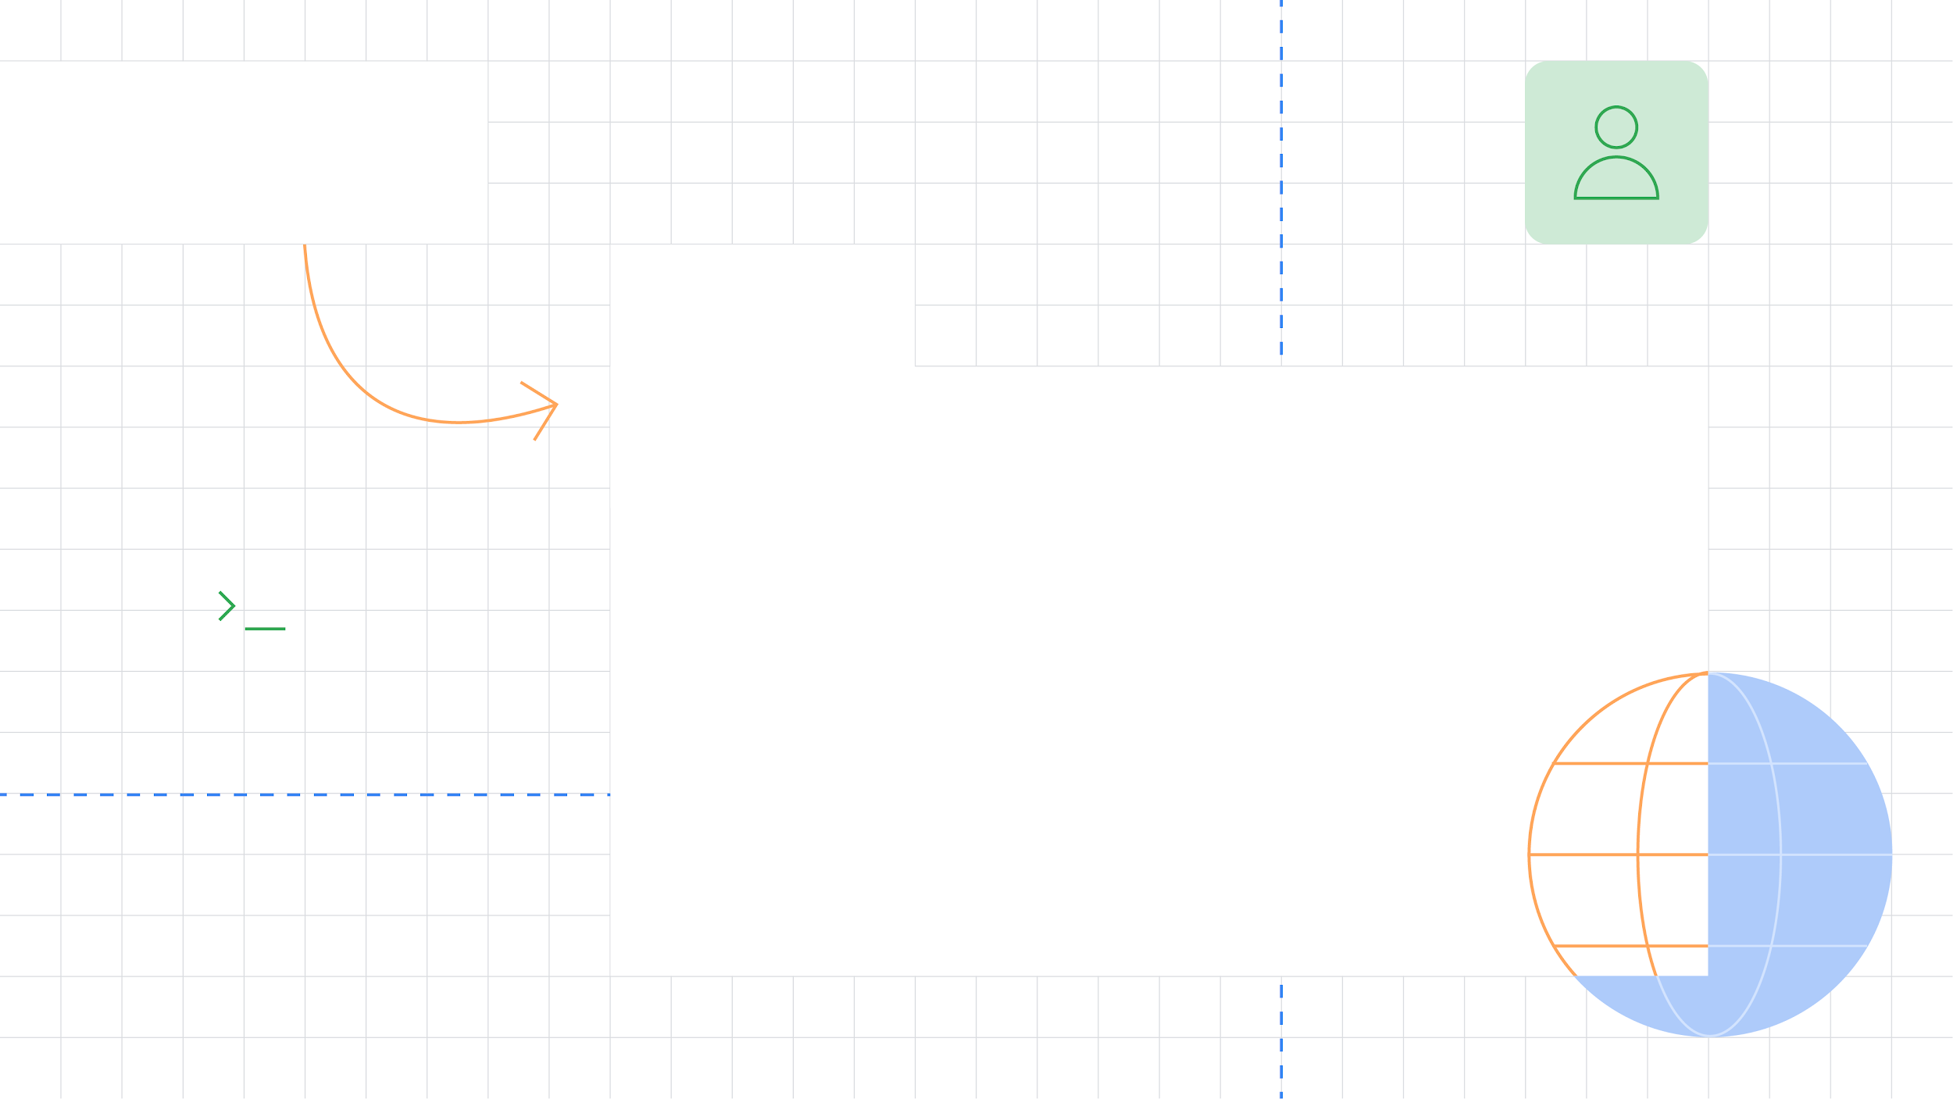






Sultan Qaboos University
DSC
Sultan Qaboos University
Introduction to Flutter & Github
Musalam Al-Balushi
Sultan Qaboos University
@squdsc & @DSC_Squ

Slide 2
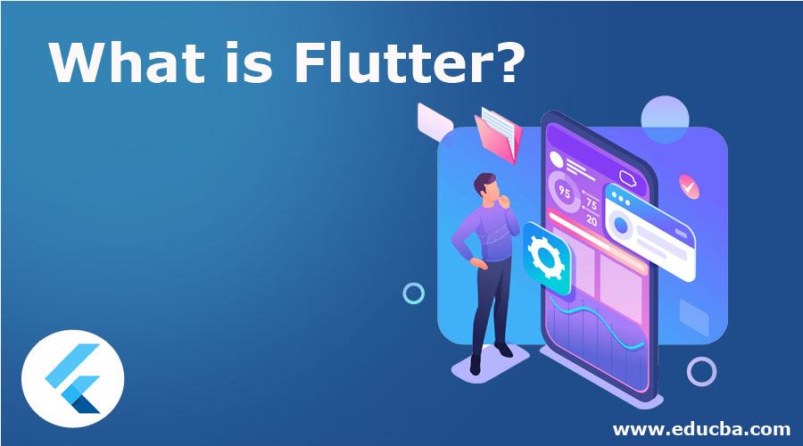

Slide 3

Hello, I am Khalid

Slide 4
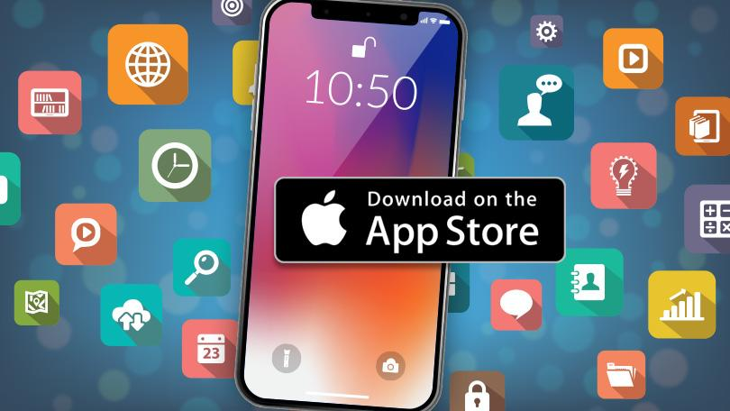

Slide 5
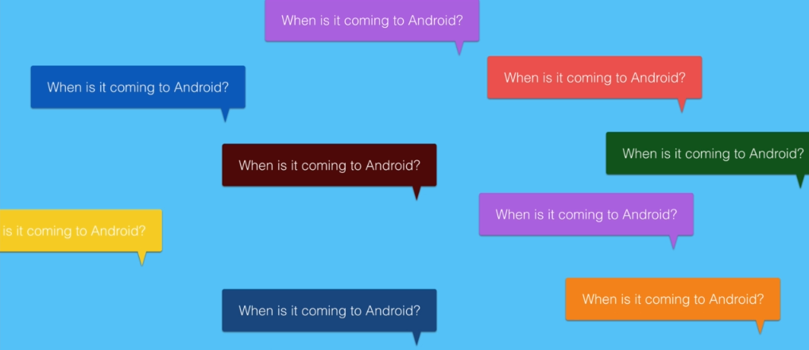

Slide 6
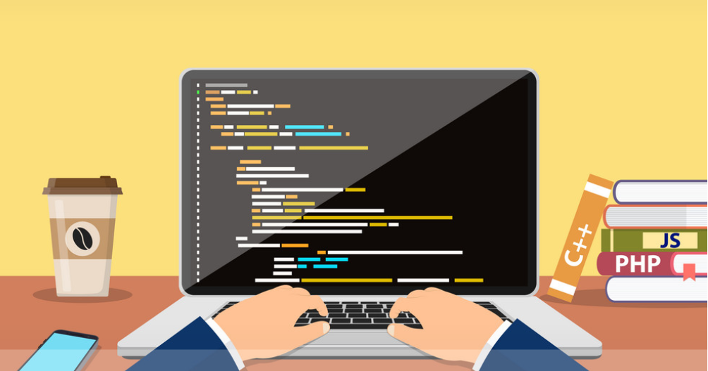
Java
Android programming

Slide 7
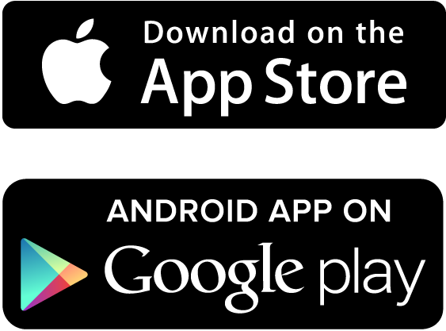

Slide 8


Slide 9
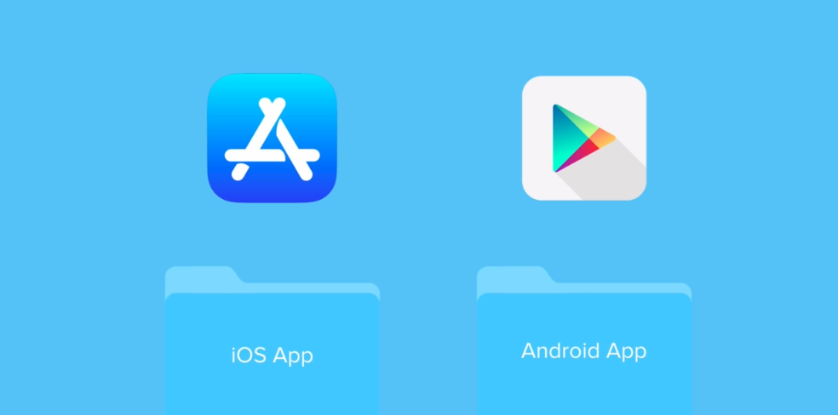

Slide 10
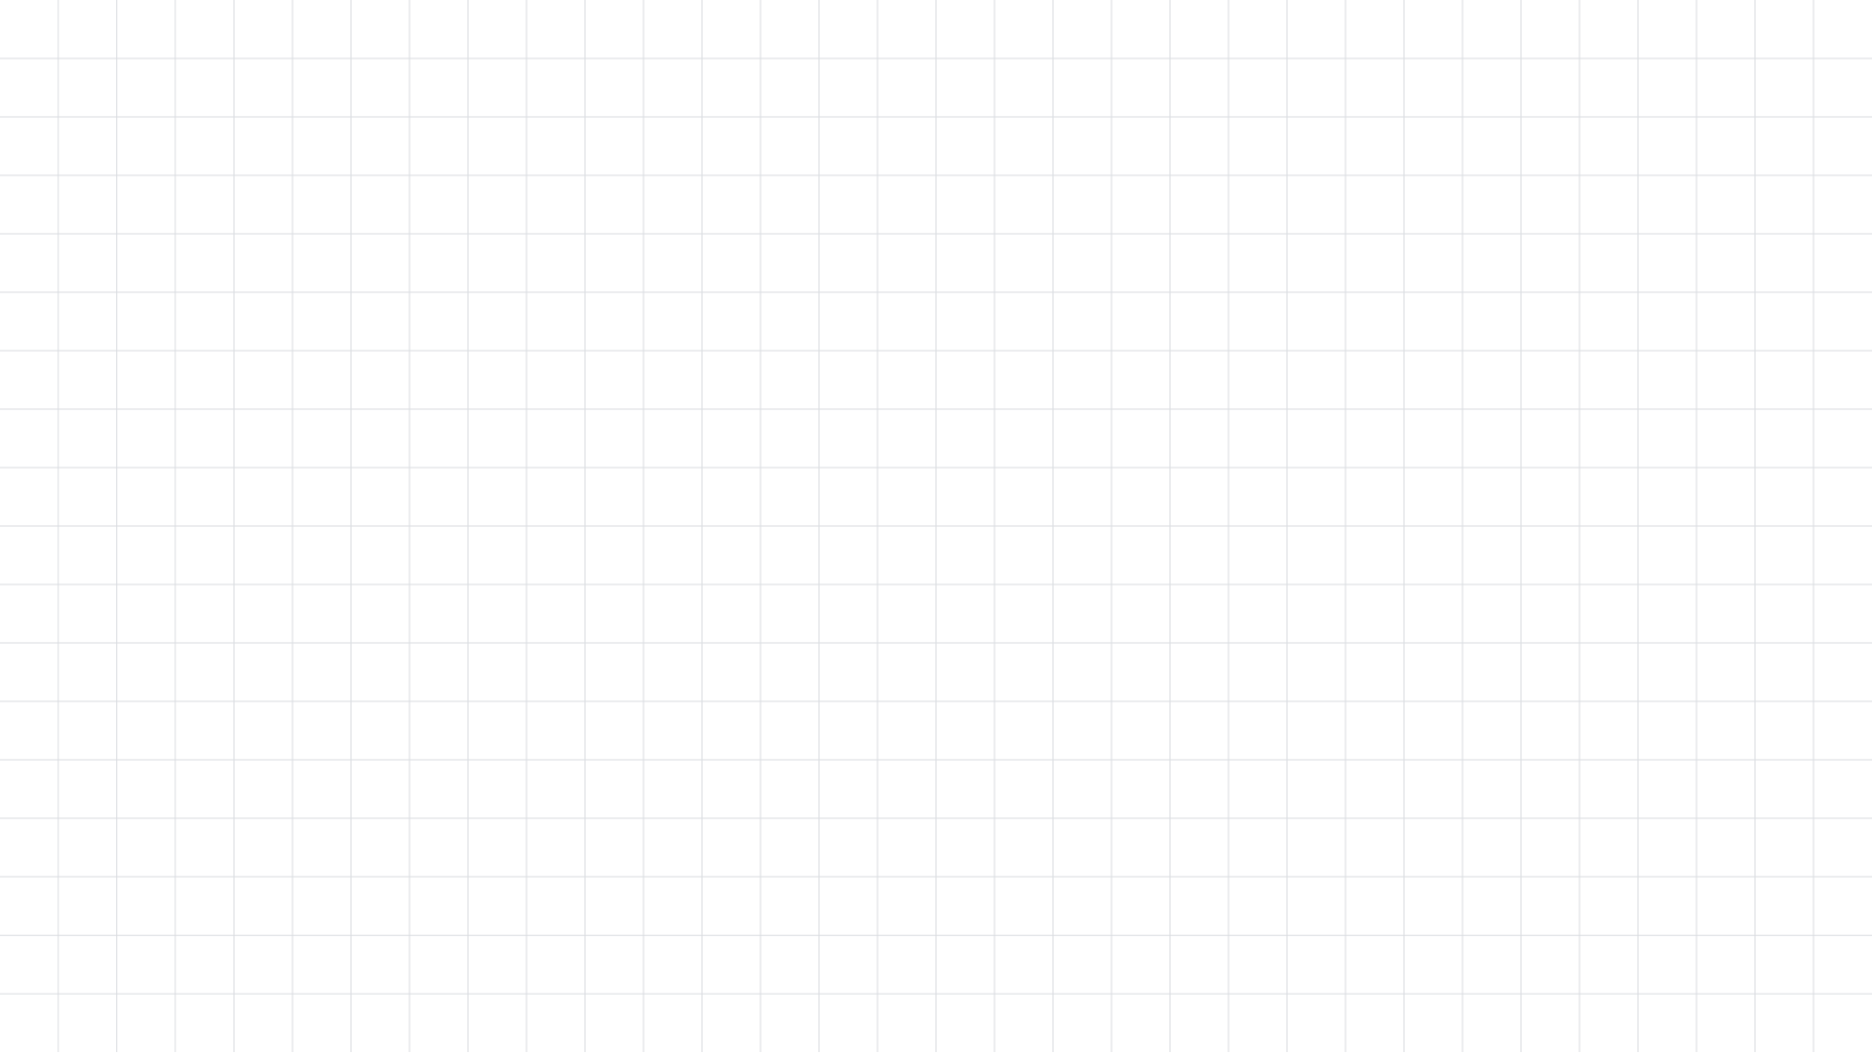



Flutter
DSC

Slide 11
Why Flutter?
One code base for both iOS and Android.
Flutter is the only mobile SDK that provides reactive views without requiring a JavaScript bridge.
Flutter apps look and feel great.
Make a change in the app and see them in the blink of an eye. All thanks to Hot-Reload.
DSC

Slide 12
Why Flutter?
Uses Dart as main language
Open source
Supports many IDEs
Flutter is all widgets
DSC

Slide 13
Dart language
Dart SDK – includes liberaries & command line tools
Dart VM – online version ~ dartpad
Dartanalyzer –statically analyzes code
Pug, dart2js, dartfnt
DSC

Slide 14
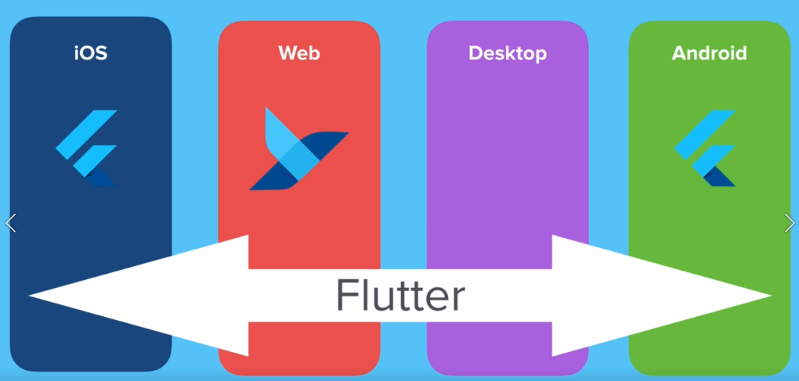

Slide 15

Flutter is all about widgets
Parts build beautiful UI
Thingy
DSC

Slide 16
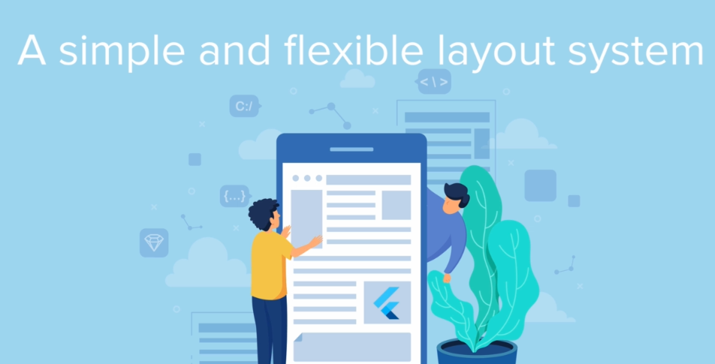
ff
DSC

Slide 17
React native VS Flutter
DSC

Slide 18
ff
Widgets
There are broadly two types of widgets in Flutter.
State-full Widgets and Stateless Widgets. The names are self-explanatory.
State-full Widgets are sensitive to what happens within its boundaries and gets rebuilt when a state change is detected. Conversely, Stateless widgets are not state sensitive and remain static throughout its life cycle.
DSC

Slide 19
ff
Container Widget
Containers are widgets that wrap around other child widgets to define their:
Alignment- aligns the child widgets
Constraints
Decoration
transform- helps to apply transformations to the child widgets.
DSC

Slide 20
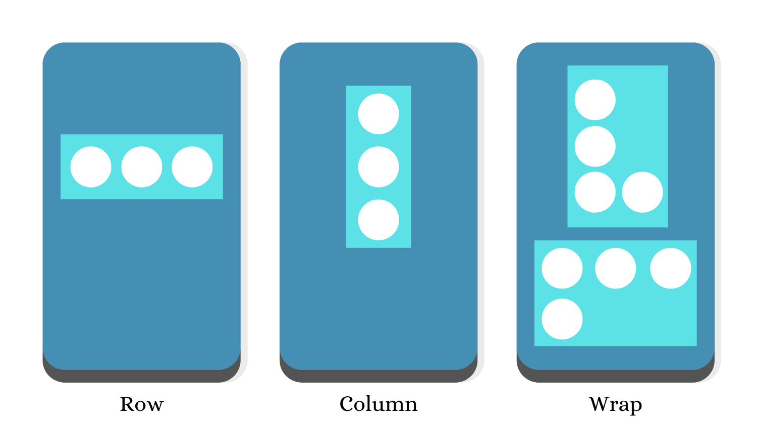
ff
Row, Column and Wrap Widget
DSC

Slide 21
ff
Let's do some work
DSC

Slide 22
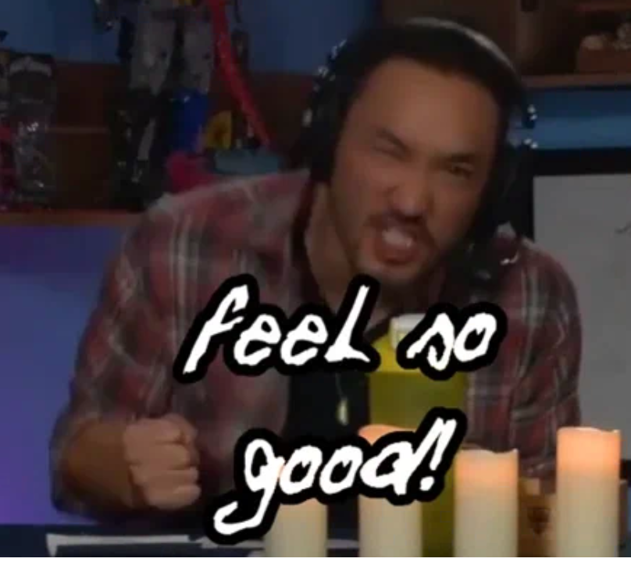
ff
DSC

Slide 23
ff
To Program with flutter what do I need
1- Download flutter sdk and add it to environment
2- Download Dart for Flutter 1.20 and below
3- Install VS code or Android Studio
4- Add flutter Plugin
5- Start coding!
DSC

Slide 24
ff
Git and Github
Version controlling
Application
Application
Application
Application
DSC

Slide 25
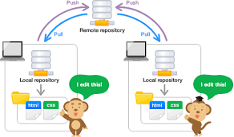
ff
Git and Github
Download Git
Add to staging area
Commit
Push and Pull
DSC

Slide 26
ff
Github
1- Download flutter sdk and add it to environment
2- Download Dart for Flutter 1.20 and below
3- Install VS code or Android Studio
4- Add flutter Plugin
5- Start coding!
DSC

Slide 27
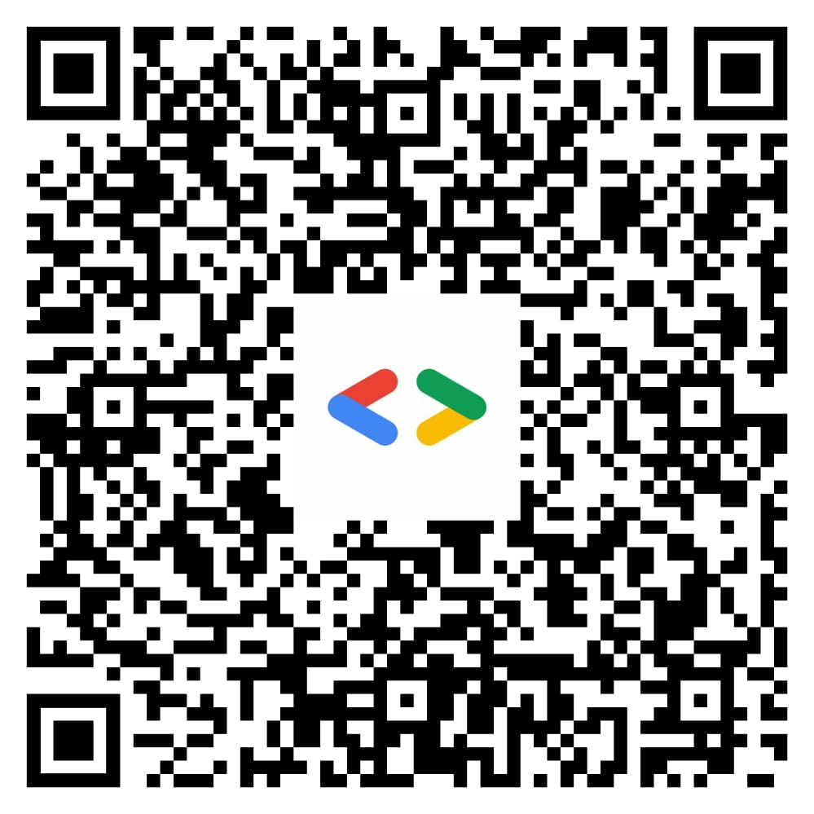
ff
DSC

Slide 28
Sultan Qaboos University
DSC
Sultan Qaboos University
Introduction to Flutter
Musalam Al-Balushi
Sultan Qaboos University
@squdsc & @DSC_Squ

